Slide 1



credit APPROVAL USING SOCIAL NETWORK Information
Group Members - Abhilesh Gaikwad, James Anderson, Maurice Le Gendre

Slide 2

STANDARD APPROVAL
Credit Report or Credit Score
Income
Debt to Income Ratio

Slide 3
PROBLEMS WITH STANDARD APPROVAL
Difficult to judge borrowers credit worthiness
Set Parameters – Income, Credit file, Defaults

Slide 4
Questions
Does analyzing borrowers' social networks determine their credit scores more accurately?
01
How can social network data be incorporated within the traditional credit risk assessment?
03
Is it possible for lenders to predict a borrower's probability of repayment or default based on the characteristics and extent of their social network?
02

Slide 5
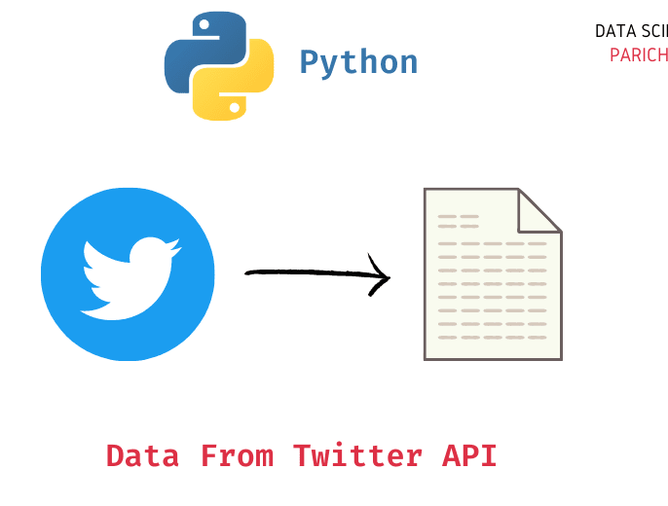

DATASET

Slide 6
Alternative Method for credit approval
Social Quality
Social Stability
Social Exposure

Slide 7



WHAT DOES YOUR SOCIAL NETWORK DATA SAY ABOUT YOU?

Slide 8
DEFINITIONS & scoring
Social Quality - counts the number of default borrowers in a borrower’s mobile address book. {0 (0.87), 1 (0.10), 2 or above (0.03)}
Social Stability - social network stability means the length of time the borrower’s mobile phone number has been used. {1 year or below (0.32), 1–3 years (0.31), >3 years (0.37)}
Social Exposure - comes from the number of contacts that the borrower fills in on the app or website when applying for a loan, including home phone, work phone, and emergency contact phone number. {1 (0.12), 2 (0.56), 3 (0.21), 4 (0.11)}

Slide 9
HYPOTHESIS
1) Social Network quality contains predictably of loan default. When the borrower applies for the loan, the platform will ask permission to access the address book.
2) Social network stability contains predictability of loan default. The longer the mobile phone number is used, the more people the borrower can contact and the closer relationship there will be in the network.
3) Social network exposure contains predictability of loan default. When borrowers apply for loans, they can choose to disclose many kinds of contact information to the platform.

Slide 10
Machine learning algorithms
Random Forest
Logistic Regression
Support Vector Machine (SVM)
Gradient Boost
Neural Networks

Slide 11
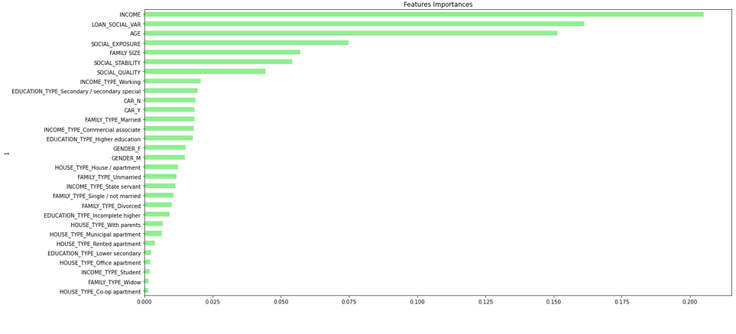

Slide 12
results
Random Forest Accuracy - 0.58 Precision – 0.49 Recall – 0.29
Logistic Regression Accuracy - 0.59 Precision – 0.51 Recall – 0.18
SVM
Accuracy - 0.59 Precision – 0.55 Recall – 0.11
Gradient Boosting Accuracy - 0.58 Precision – 0.51 Recall – 0.30
Neural Network Accuracy – 0.92 Loss – 0.56

Slide 13
Conclusions
By extracting social network data, we were able to predict borrower behaviour, but not with a level of precision that we would feel comfortable utilising at a financial institution. Because of how interconnected modern society is, information from social networks can reveal a borrower's credit standing. Almost everyone has access to a phone, which can store a lot of social network data.

Slide 14
CHALLENGES
Creating a standard dataset & cleaning data
Limited time
Lack of Resources

Slide 15

QUESTIONS

